Slide 1
Proximity Pricing
Trey Kolos, Brandon Grill, Aidan Sakata, Braulio Quintana, Devin Dubois
Using machine learning techniques to predict how the proximity to a point of interest influences house prices in a particular area.

Slide 2
Project Concept
The inspiration for the idea is to take a dataset containing house pricing data and the location of each house and be able to predict the price of a home based on its proximity to a point of interest.
The model would train on houses within a certain radius from a point of interest (such as a park or a stadium) and be able to predict the price of houses based on their distance from that point.

Slide 3
Methodology
Analyze Miami Housing dataset
Data Preprocessing
Establish POI methods and define POIs
Create and train models
Evaluate the models
Draw conclusions

Slide 4
Miami Housing Dataset Analysis
The dataset contains information on 13,932 single-family homes sold in Miami in 2016.
The data set came with coordinates for each home as well as features that contribute to the price of homes, including the square footage of the land area and living areas and the age of the structure as well as the actual sale price of the property.
Our team performed data analysis to determine which features contributed to the price of the house and removed features that were either irrelevant to the price, incomplete, or did not significantly contribute to the sale price of the homes.
-avno60plus, month_sold, PARCELNO, structure_quality, HWY_DIST
Identify SALE_PRC as target variable, preprocess X variables

Slide 5
Data Preprocessing
After reviewing the dataset we removed anomalies in SALE_PRC by finding the IQR and excluding the upper and lower bounds
This improves the robustness of the model and prevents overfitting. Largely removed million $+ homes that are unrepresentative of the expected single family homes (one or two rich neighborhoods), and creates a model that better models the market.
We scaled the X variables for the model with MinMaxScaler
Normalized data, prevents mathematical error with model calculations
Drop avno6plus, month_sold, PARCELNO
not useful for any model

Slide 6
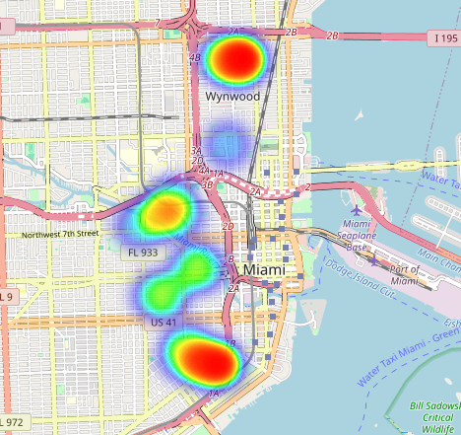
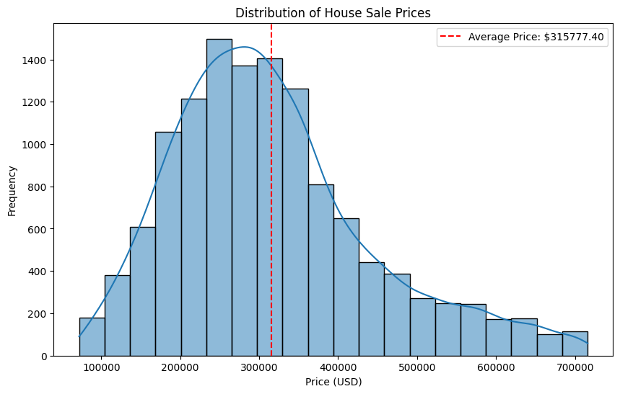
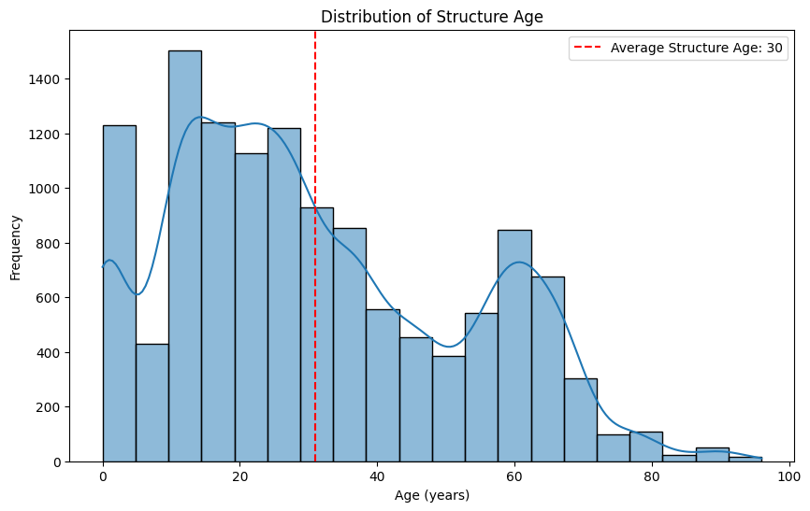
Data Analysis
These graphs give insight into the specifics of the dataset that inform how we develop the models, and expose potential problems with the features.
Folium library to place the data on a real interactable map helps to find suitable POIs to match dataset

Slide 7
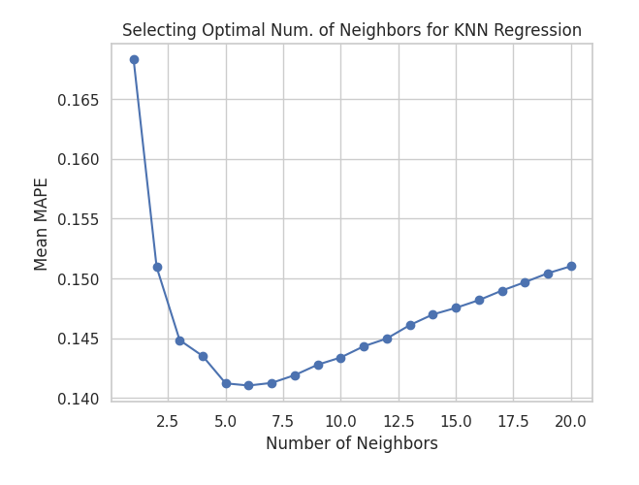
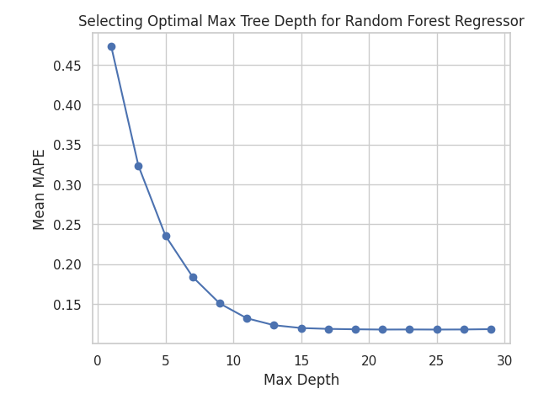
Creating and Training models
Models were trained with an 80-20 training testing split
Random forest
Find feature importance
Linear Regression
ElasticNet, 0.7 l1 ratio
KNN Regressor
5 Neighbors, capture patterns of close house groups
XGB
Squarederror loss objective, 1000 estimators, 0.05 learning rate, 10 early stopping rounds, capture nonlinear feature relationships
Neural Network
Sequential(), Dense(128), LeakyReLu, Dropout(0.2), Dense(64), LeakyReLu, Adam Optimizer MSE Loss, 1000 epochs, 0.2 validation split

Slide 8
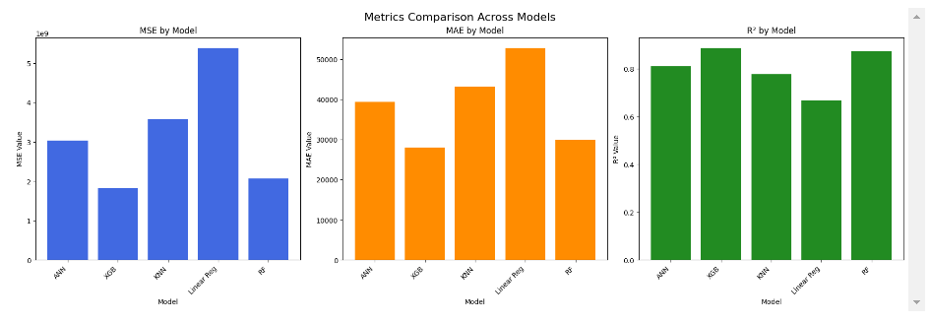
Original Features predicting SALE_PRC
Which models perform best to consider for later methods

Slide 9
Evaluating the models
We found the MSE, MAE, R² scores of the models and compared side by side to find which models were the best fit to the dataset. MAE tend to be quite high as they represent the average dollar amount that the predicted price is off by. R² represents what % of the data is represented accurately by the model.
These first models helped determine which features affected the price the most.
This inspired our approach as we experiment with feature engineering and newer models.

Slide 10
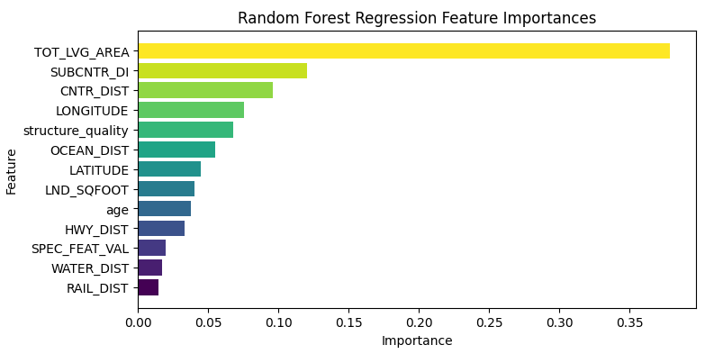
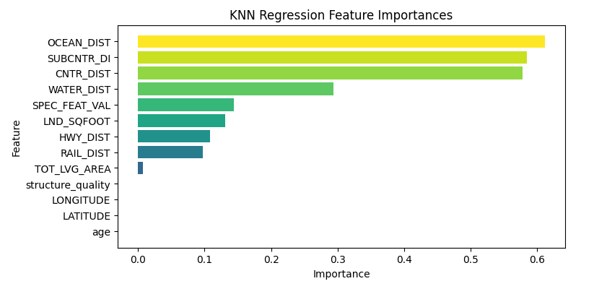
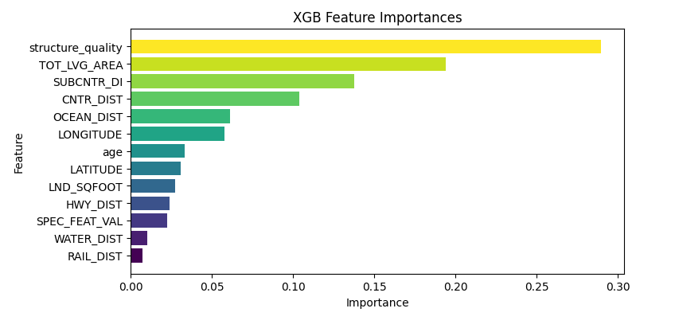

Slide 11
Methodology 1: Finding Points of Interest
We calculated the Euclidean distance between the houses and the points of interest with a function and created a method to create a dataframe of all the houses within a certain radius from a point.
FTX Arena (prototype)
Found that the distance from a poi is insignificant around 10 miles, use closer radius for housing groups
6 miles radius Bayfront Park, 6 miles radius University Miami Hospital, 6 miles radius Little Haiti Soccer Park

Slide 12
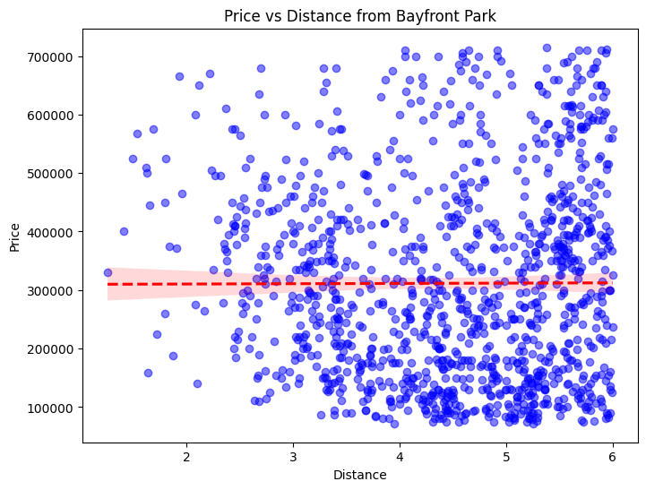
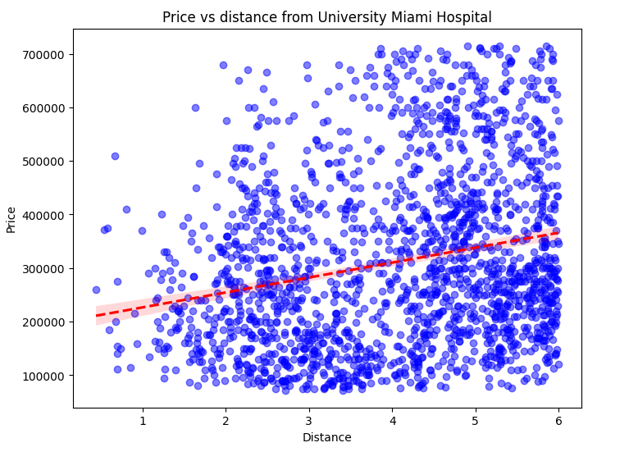
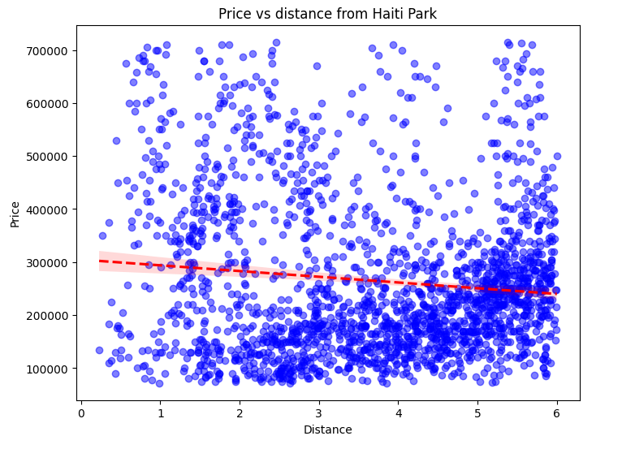
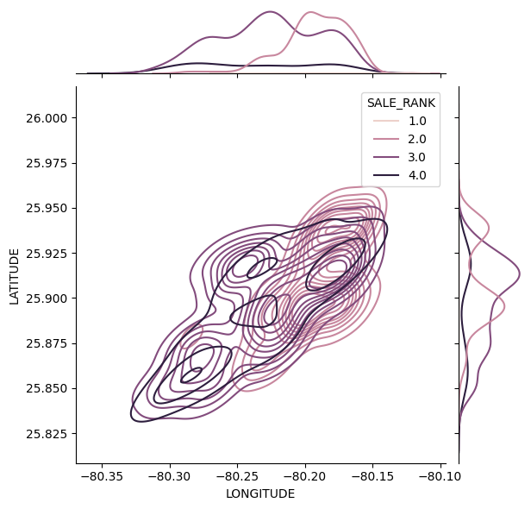
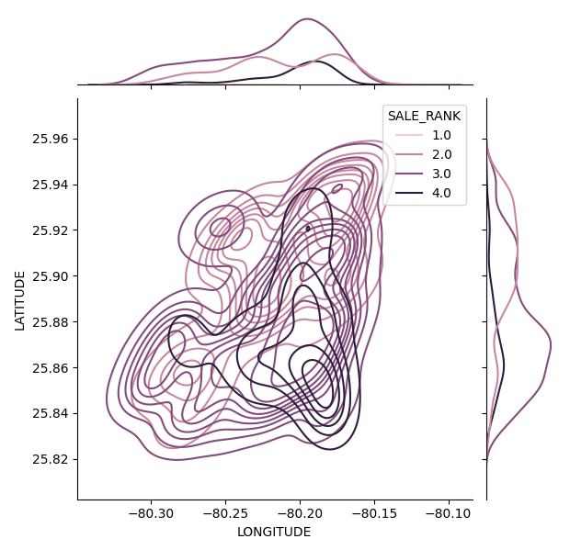
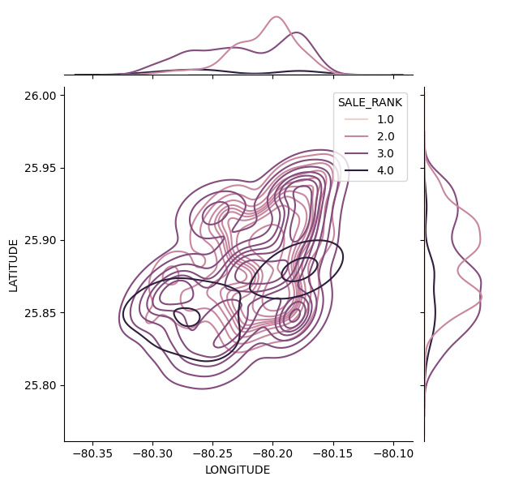
Price from Bayfront Park
Price from University Miami Hospital
Price from Haiti Park

Slide 13
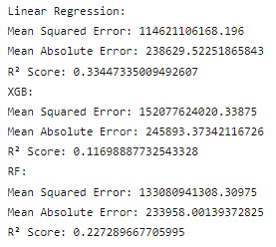
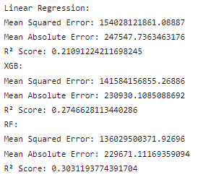
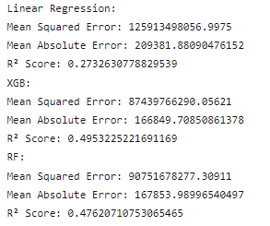
Price from Bayfront Park
Price from University Miami Hospital
Price from Haiti Park

Slide 14
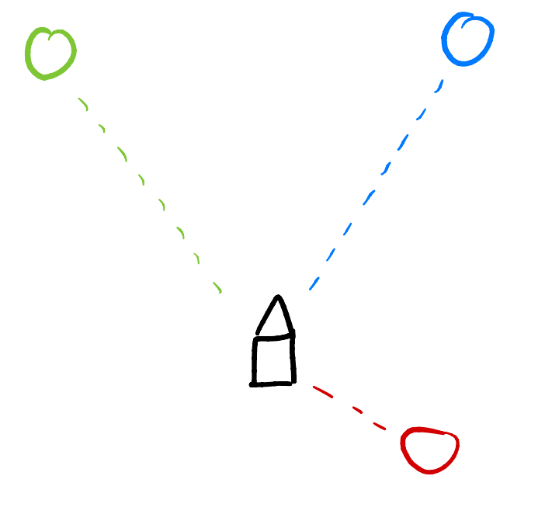
Conclusion:
There is little correlation between sale price and distance from a single point of interest.
New hypothesis - Do multiple points of interest correlate to the price of a home?

Slide 15
Next Steps: New methods (Methodology 2)
Similarly to the original dataset parameters on distance from the city center or the ocean, we decided to engineer our own features that represented the distance of houses from other significant locations.
We created dataframes that took data from Miami Dade County’s open database and grouped locations together.
Private schools, charter schools, public schools, ports, metrorail, parks, malls
New target variable: price per unit living area
We found that with new models, these points did not significantly contribute to the price per living area. Other houses in the same neighborhood were similarly priced, independent of their distance from parks, schools, etc.

Slide 16
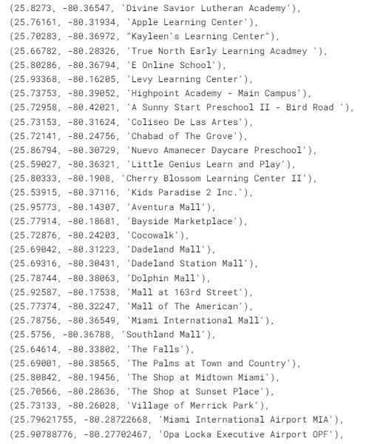
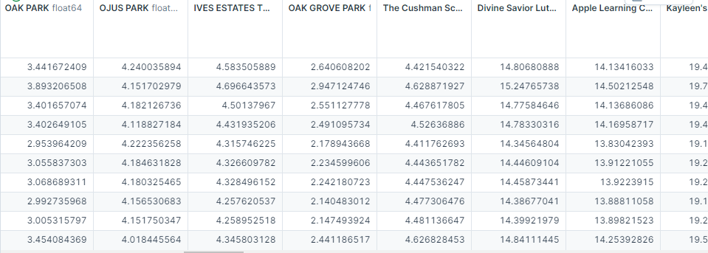
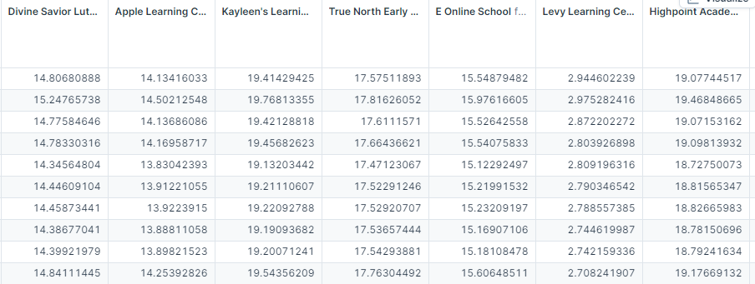
List of POIs
Converted feature from POIs

Slide 17
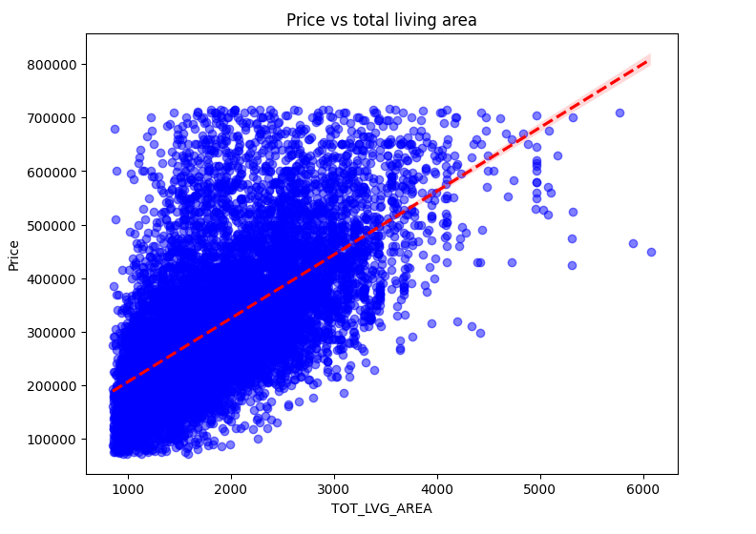
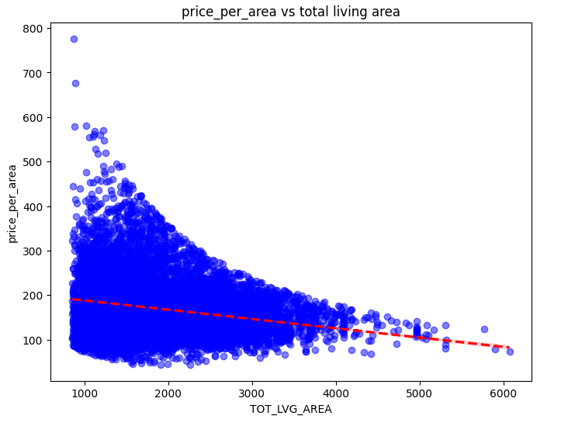
Target variable

Slide 18
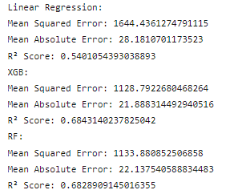
Feature Engineering Overview and new Target Value
75 new features based on the pois around the city
15 malls
15 schools
15 parks
15 metro rail stops
15 miami port stops
New target variable smooths out the differences in the price ranges and makes things a little more standardized.

Slide 19
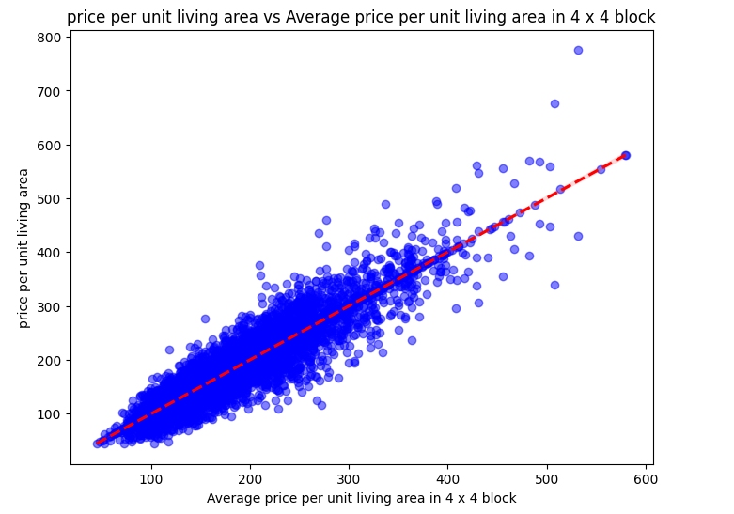
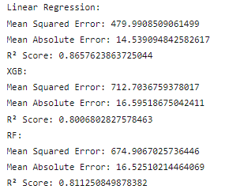
4 x 4 block average (new feature)
When taking in consideration a 4 x 4 block average price per square foot livable area we get much more accurate results

Slide 20
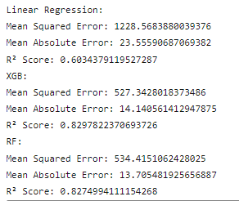
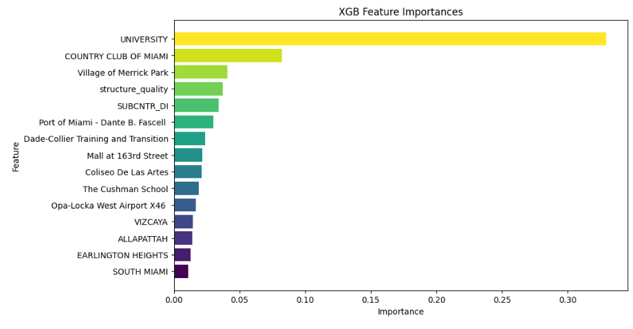
Methodology 3 (last test)
We wanted to measure whether there is a correlation between the averages of a 4 x 4 block of price per square foot livable area and the city amenities around it.
We found that there is a higher correlation of the neighborhoods price range when considering only the city amenities around it local area.

Slide 21
Dataset Drawbacks
Dataset only includes data for single family homes sold in 2016. such a short period of time for sales can not be generalized to the importance of miami landmarks in 2024. The city of Miami looked different in 2016 (Chosen POIs not built / under construction).
The dataset included many parameters that were found to be not significant via feature importance analysis or irrelevance to our specific goal. Including:
-avno60plus: airplane noise
-structure_quality: quality of the structure (1-5) but what does the scale mean? How is it determined? Dataset did not include that information.
-
Meanwhile, some parameters were missing that could have been used to normalize house prices to draw out the location significance such as specifically mentioning special features such as whether the property has a pool or a balcony.

Slide 22
Project Applications
Initially began with the idea of creating a user tool for housing construction companies to utilize in order to predict future house sale prices
In the last segment of our code we have our user input section which allows for a user to input the longitude and latitude values of a potential new house along with its square footage

Slide 23
Conclusion
Some of the methods that we tried were found to not be very effective, while we had great success with feature engineering that can prove that there is merit to finding POIs and using them to predict house prices.
The methods researched can be expanded for real estate purposes, such as what city features contribute to house prices.
If we were to start over and make a similar model, using a more complete dataset with data that spanned a few years over a larger area would be ideal and may lead to different significant outcomes. We would also want to scrape more points of interest for a well-rounded regression model.

